Slide 1


Pure Water Antelope Valley Project Public Hearing: Draft Initial Study – Mitigated Negative Declaration, and Mitigation Monitoring and Reporting Program
Board of Directors Meeting
December 15, 2025

Slide 2

Purpose of Today’s Hearing
Present the Draft Initial Study and Mitigated Negative Declaration
Present the Mitigation Monitoring and Reporting Program
Summarize the CEQA process
Receive any public comments
Close the public hearing after comments

Slide 3
Project Overview
Pure Water Antelope Valley is a new regional water supply program that will:
Produce highly purified recycled water using full advanced treatment
Replenish the Antelope Valley Groundwater Basin through direct injection
Improve long term drought resilience and water supply reliability
Support the District’s Strategic Water Resources Plan

Slide 4
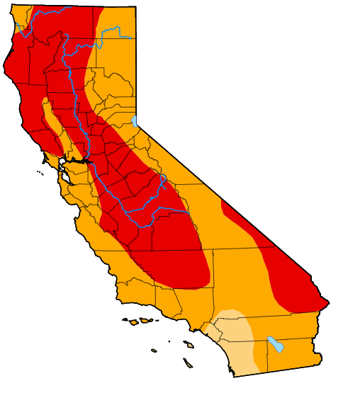
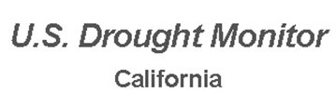
Why?
Drought-Proof
• Local groundwater basin is overdrafted • Enhances drought reliability • Reduces dependence on imported water • Supports 2050 Strategic Water Resources Plan goals

Slide 5
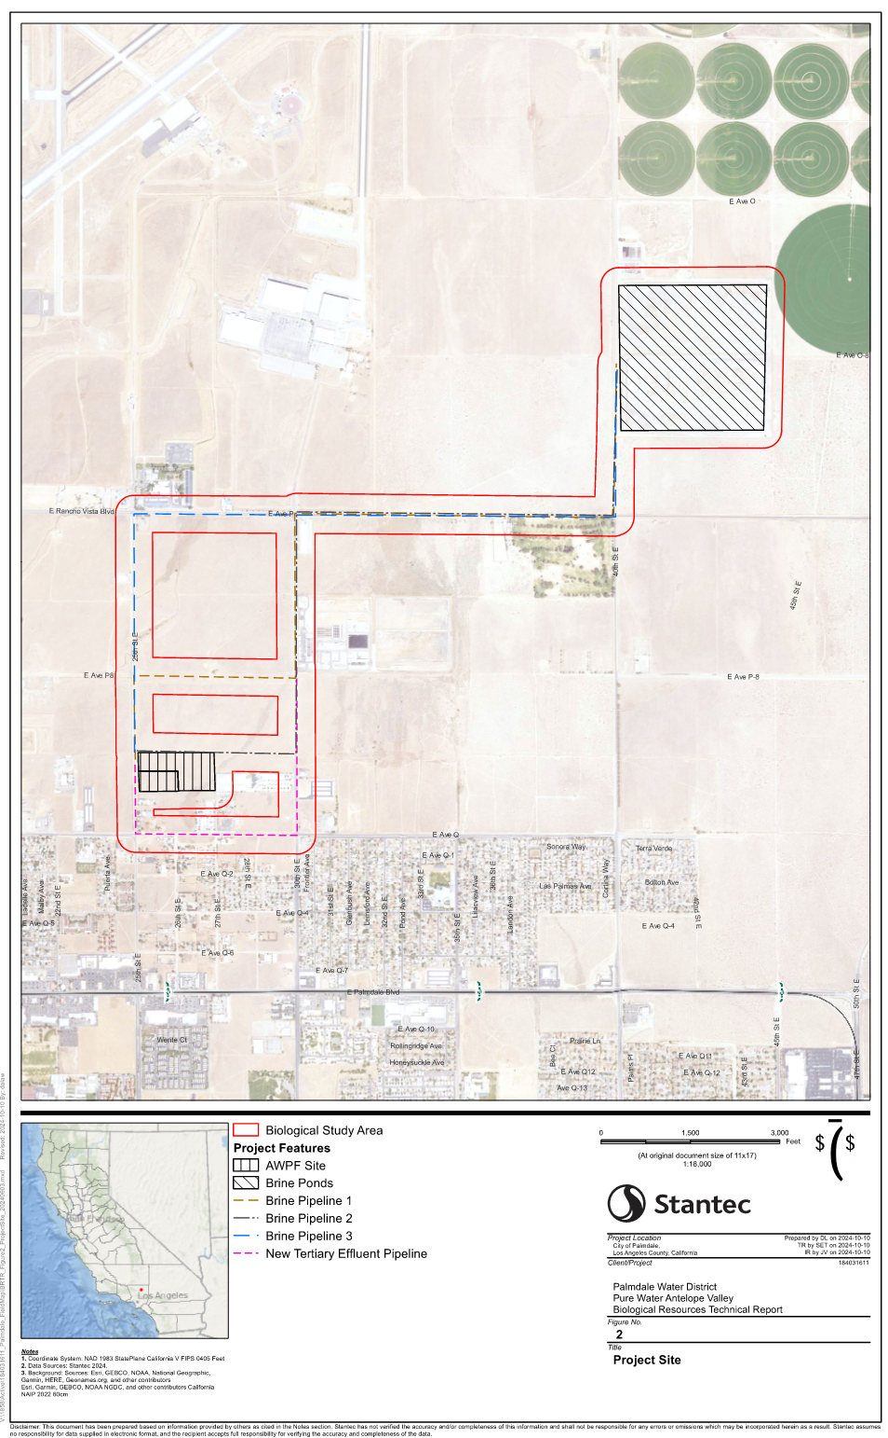
Project Components
The project includes construction and operation of:
A full-scale Advanced Water Purification Facility (AWPF)
Injection wells for groundwater recharge
Product water pipelines
Brine management system using existing Oxidiation ponds
Replacement production well (Well 37)
Tertiary effluent pump station and pipeline

Slide 6
CEQA Process Summary
IS/MND prepared by Stantec
Released to the State Clearinghouse on Oct 21, 2025
30-day public review period ended Dec 9, 2025
Notice of Intent posted online and sent to LA County Recorder’s Office
Sent NOI to multiple agencies and contacts in the Antelope Valley
Legal notices published Oct 17 and Nov 14, 2025 in AV Press

Slide 7
Environmental Review Findings
The Initial Study evaluated:
Aesthetics
Air Quality
Biological Resources
Cultural & Tribal Resources
Hydrology & Water Quality
Transportation
Noise
Geology, Hazards, and more
The IS/MND concludes that all potential impacts can be reduced to less than significant with mitigation.

Slide 8
Key Mitigation Areas
Mitigation is required for:
Biological resources: western Joshua trees, nesting birds, special status species
Aesthetics: landscape plan, lighting controls
Cultural/tribal resources: worker training, discovery procedures
Transportation: Caltrans encroachment conditions, Traffic Management Plan
Noise: construction limits
Paleontology: monitoring in sensitive soil layers

Slide 9
Mitigation Monitoring and Reporting Program (MMRP)
The MMRP ensures:
All mitigation measures are implemented
Monitoring responsibilities are clearly assigned
Documentation is maintained for agency compliance
Tribal coordination and biological notification requirements are met
Noncompliance procedures are in place

Slide 10
Summary of Comments Received
Four comment letters were received:
Federal Aviation Administration
Los Angeles County Sanitation Districts
California Department of Fish and Wildlife (CDFW)
Caltrans
All agencies agreed with the analysis, and their comments focused on:
Permit requirements
Biological clarifications
Traffic and encroachment compliance
Brine pond considerations

Slide 11
Staff Responses
All comments were reviewed and addressed
Mitigation clarifications incorporated into the Final IS/MND and MMRP
No new significant impacts were identified
No recirculation required under CEQA

Slide 12
Public Involvement
Public had multiple opportunities to comment:
State Clearinghouse review
Newspaper notices
District website postings
Tonight’s public hearing
No comments were received indicating unmitigated significant impacts

Slide 13
Public Hearing Procedure
Staff presented the ISMND and MMRP.
Board President to open the public hearing
Receive public comments and/or Board questions
Close the hearing after all comments are received
No action on Resolution adoption occurs in this item.

Slide 14
Questions?

Slide 15
ADOPT a RESOLUTION OF THE BOARD OF DIRECTORS OF THE PALMDALE WATER DISTRICT ADOPTING THE DRAFT INITIAL STUDY - MITIGATED NEGATIVE DECLARATION
Board of Directors Meeting
December 15, 2025

Slide 16
Resolution 25-11
Resolution 25­-11 will:
Adopt the Initial Study and Mitigated Negative Declaration
Adopt the MMRP
Document Board findings under CEQA
Direct staff to file the Notice of Determination

Slide 17
Staff Recommendation
Staff recommends the Board:
Adopt the IS/MND for the Pure Water AV Project
Adopt the Mitigation Monitoring and Reporting Program
Approve Resolution 25-­11
Authorize staff to file the Notice of Determination

