Slide 1

Public Health Goal Report
Amanda Thompson
Water Quality and Regulatory Affairs Supervisor
July 2025

Slide 2


Background
The California Safe Drinking Water Act of 1996
  Required the establishment of Public Health Goals (PHGs) for drinking water contaminants
  PHGs are established by the Office of Environmental Health Hazard Assessment (OEHHA)
Health and Safety Code Section 116470
  Requires a PHG report every three (3) years
  In addition to the annual Water Quality Report (aka Consumer Confidence Report)

Slide 3

Public Notice
State law requires a Public Hearing so that interested individuals can provide the District with comments on the Public Health Goal report.
Palmdale Water District Notice of Public Hearing published twice in the Antelope Valley Press:
  June 21, 2025
  June 28, 2025

Slide 4

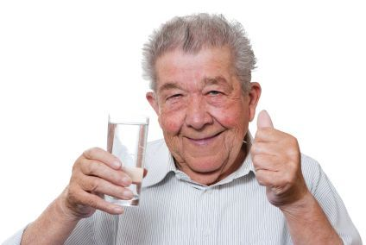
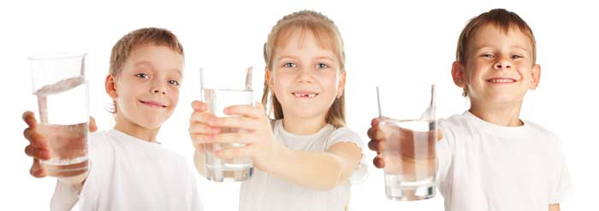
What are Public Health Goals?
“…estimates the level of the chemical in drinking water that would pose no significant health risk to individuals, including sensitive populations, consuming the water on a daily basis over a lifetime.
PHGs represent health-protective goals based solely on public health considerations and are developed based on the best available data in the scientific literature.”

Slide 5
What Public Health Goals Are Not
NOT regulatory Maximum Contaminant Levels (MCLs)
  However, they are the scientific basis for establishing the maximum contaminant levels
NOT enforceable under the Safe Drinking Water Act
NOT contaminant levels requiring any further action

Slide 6


Water Quality Data Considered
PHG Report is based on all regulatory water quality data collected during the previous three-year period (e.g. 2022, 2023 & 2024)
2022, 2023 & 2024
Only includes constituents with an established public health goal and are detected at or above its detection level for purposes of reporting (DLR)

Slide 7
2025 Public Health Goal Report
Constituent | PHG (MCLG) | DLR | TT | PWD Maximum Result
Total Coliform | (0%) | NA | <5.0% | 0.8%
Coliform bacteria are an indicator organism that are naturally present in the environment and are not generally considered harmful.
The USEPA and California State Treatment Technique (TT) is no more than 5.0% samples total coliform-positive (TC-positive) in a month.

Slide 8
2025 Public Health Goal Report
Constituent | PHG (MCLG) | DLR | MCL | PWD Maximum Result
Arsenic | 0.004 µg/L | 2 µg/L | 10 µg/L | 2.9 µg/L
Chromium, Hexavalent | 0.02 µg/L | 0.1 µg/L | 10 µg/L | 8.8 µg/L
Copper | 0.30 mg/L | 0.05 mg/L | 1.3 mg/L | 0.42 mg/L
Perchlorate | 1 µg/L | 1 µg/L | 6 µg/L | 3.6 µg/L

Slide 9
2025 Public Health Goal Report
Constituent | PHG (MCLG) | DLR | MCL | PWD Maximum Result
Gross Alpha | (0 pCi/L) | 3 pCi/L | 15 pCi/L | 13 pCi/L
Gross Beta | (0 pCi/L) | 4 pCi/L | 50 pCi/L | 4.6 pCi/L
Uranium | 0.43 pCi/L | 1 pCi/L | 20 pCi/L | 3.8 pCi/L

Slide 10

Total Compliance
Palmdale Water District has been 100% in compliance with all primary drinking water standards during 2022 – 2024.
Palmdale Water District continues to produce high-quality drinking water which is in compliance for the first half of 2025.

Slide 11
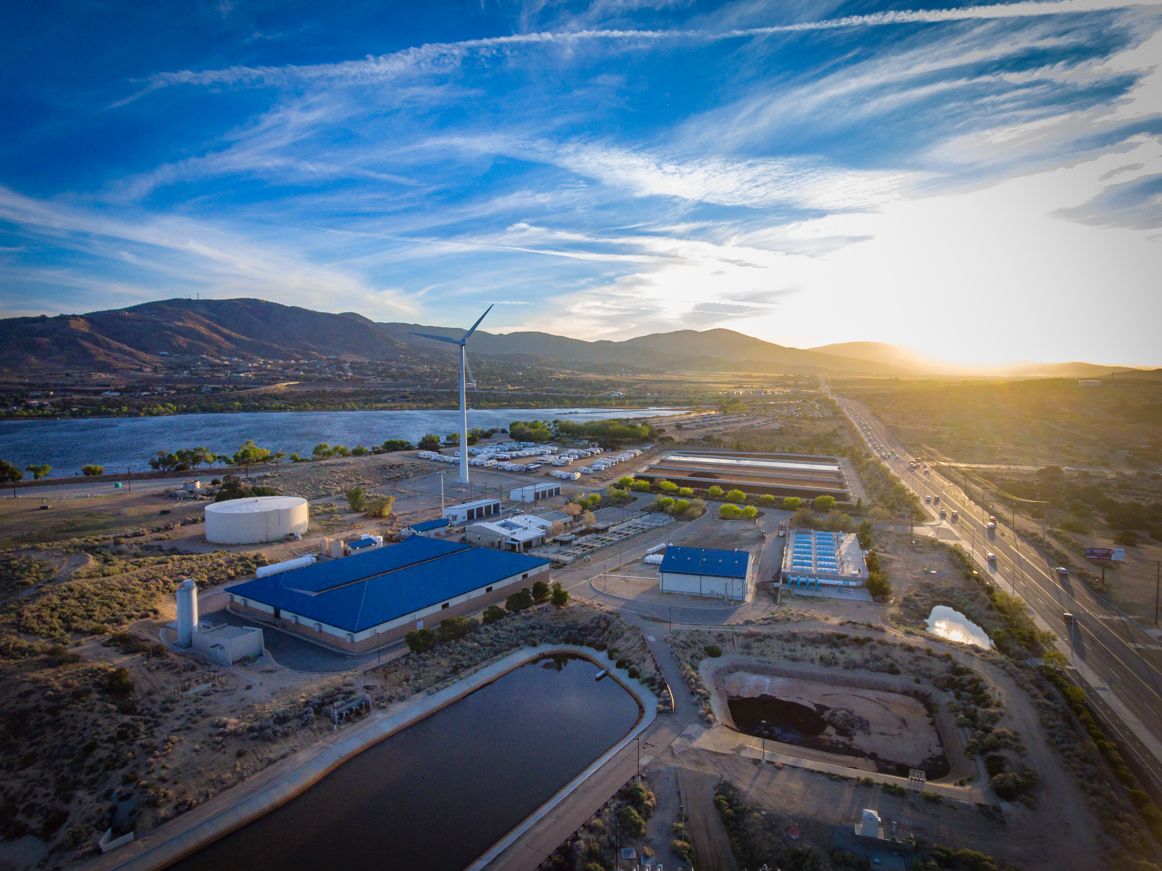
QUESTIONS?

